Slide 1
CSIT 404 VOICE COMMUNICATION TECHNOLOGY
Session 2 –Introducing Voice over IP Networks
Lecturer: Mr. Paul Nii Tackie Ammah, CSD
Contact Information: pntammah@gmail.com

Slide 2
Session Overview
This session describes VoIP, components of a VoIP network, the protocols used, and service considerations of integrating VoIP into an existing data network.
Also, this session considers various types of voice gateways and how to use gateways in different IP telephony environments.

Slide 3
Session Outline
The key topics to be covered in the session are as follows:
VoIP Fundamentals
VoIP Functions
VoIP Signaling Protocols
VoIP Service Considerations

Slide 4
VoIP Fundamentals
Topic One

Slide 5

Introduction
Voice over Internet Protocol (VoIP) allows a voice-enabled router to carry voice traffic, such as telephone calls and faxes, over an Internet Protocol (IP) network.
Voice over IP is also known as VoIP. Sometimes VoIP is referred to as IP Telephony. Both terms refer to sending voice across an IP network.
The primary distinction revolves around the endpoints in use
VoIP routes voice conversations over IP-based networks, including the Internet.

Slide 6
VoIP Overview
VoIP is the family of technologies that allows IP networks to be used for voice applications, such as telephony, voice instant messaging, and teleconferencing.
VoIP defines a way to carry voice calls over an IP network, including the digitization and packetization of the voice streams.
VoIP services convert your voice into a digital signal that travels over an IP-based net- work.
If you are calling a traditional phone number, the signal is converted to a traditional telephone signal before it reaches its destination.
VoIP allows you to make a call directly from a computer, a VoIP phone, or a traditional analog phone connected to a special adapter.

Slide 7
Business Case for VoIP
The business advantages that drive the implementation of VoIP networks have changed over time.
Advances in voice technologies allow organizations and service providers to differentiate their product offerings by providing the following:
Cost Savings
Flexibility
Advanced Features such as Advanced call routing, Unified Messaging, Integrated Information Systems, Long-distance toll bypass, Security, Customer relationships, Telephone application Services

Slide 8
Cost Savings
Traditional time-division multiplexing (TDM), which is used in the public switched telephone network (PSTN) environment, dedicates 64 kbps of band- width per voice channel.
This approach results in bandwidth being unused when no voice traffic exists.
VoIP shares bandwidth across multiple logical connections, which results in a more efficient use of the bandwidth, thereby reducing bandwidth requirements.

Slide 9
Flexibility
The sophisticated functionality of IP networks allows organizations to be flexible in the types of applications and services they provide to their customers and users.
Service providers can easily segment customers.
This helps them to provide different applications, custom services, and rates depending on traffic volume needs and other customer-specific factors.

Slide 10
Advanced Features
Following are some examples of the advanced features provided by current VoIP applications
Advanced call routing: When multiple paths exist to connect a call to its destination, some of these paths might be preferred over others based on cost, distance, quality, partner handoffs, traffic load, or various other considerations.
Least-cost routing and time-of-day routing are two examples of advanced call routing that can be implemented to determine the best possible route for each call.

Slide 11
Advanced Features (cont.)
Unified messaging: Unified messaging improves communications and productivity. It provides a single user interface for messages that have been delivered over a variety of mediums.
For example, users can read their e-mail, hear their voice mail, and view fax messages by accessing a single inbox.
Integrated information systems: Organizations use VoIP to affect business process transformation. These processes include centralized call control, geo- graphically dispersed virtual contact centers, and access to resources and self- help tools.

Slide 12
Advanced Features (cont.)
Long-distance toll bypass: Long-distance toll bypass is an attractive solution for organizations that place a significant number of calls between sites that are charged traditional long-distance fees. In this case, it might be more cost-effective to use VoIP to place those calls across an IP network.
Security: Mechanisms in an IP network allow an administrator to ensure that IP conversations are secure. Encryption of sensitive signaling header fields and message bodies protect packets in case of unauthorized packet interception.

Slide 13
Advanced Features (cont.)
Customer relationships: The capability to provide customer support through multiple mediums, such as telephone, chat, and e-mail, builds solid customer satisfaction and loyalty.
A pervasive IP network allows organizations to provide contact center agents with consolidated and up-to-date customer records along with related customer communication.
Telephony application services: XML services on Cisco IP Phones give users another way to perform or access business applications. Some examples of XML-based services on Cisco IP Phones are user stock quotes, inventory checks, direct-dial directory, announcements, and advertisements.

Slide 14
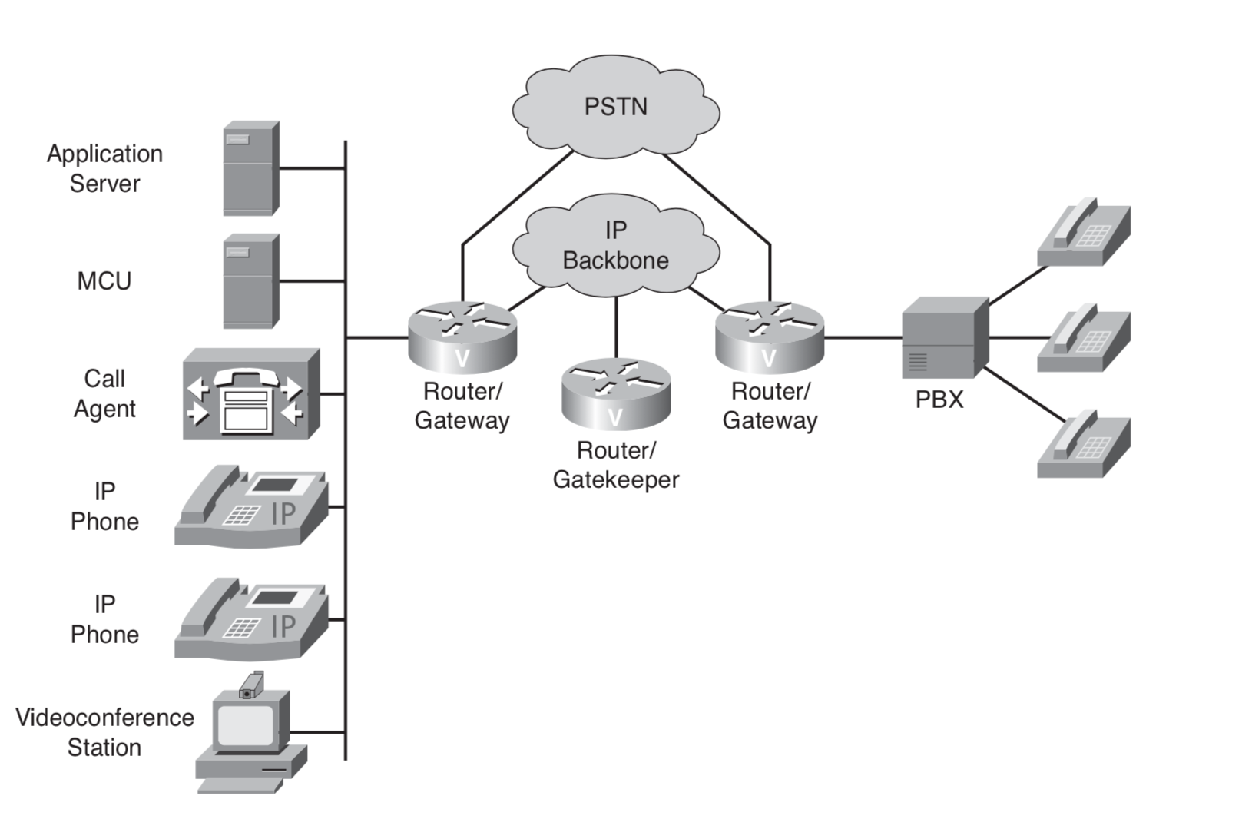
Components of a VoIP Network

Slide 15
Components of a VoIP Network (cont.)
IP Phones: Cisco IP Phones provide IP endpoints for voice communication.
Gatekeeper: A gatekeeper provides Call Admission Control (CAC), bandwidth con- trol and management, and address translation.
Gateway: The gateway provides translation between VoIP and non-VoIP networks, such as the PSTN. Gateways also provide physical access for local analog and digital voice devices, such as telephones, fax machines, key sets, and private branch exchanges (PBX).
Multipoint Control Unit (MCU): An MCU provides real-time connectivity for participants in multiple locations to attend the same videoconference or meeting.

Slide 16
Components of a VoIP Network (cont.)
Call agent: A call agent provides call control for IP phones, CAC, bandwidth control and management, and address translation. Unlike a gatekeeper, which in a Cisco environment typically runs on a router, a call agent typically runs on a server platform. Cisco Unified Communications Manager is an example of a call agent.
Application servers: Application servers provide services such as voice mail, unified messaging, and Cisco Communications Manager Attendant Console.
Videoconference station: A videoconference station provides access for end-user participation in videoconferencing. The videoconference station contains a video capture device for video input and a microphone for audio input.

Slide 17
VoIP Functions
Topic Two

Slide 18
Introduction
In the traditional PSTN telephony network, all the elements required to complete a call are transparent to an end user.
Migration to VoIP requires an awareness of these required elements and a thorough understanding of the protocols and components that provide the same functionality in an IP network.

Slide 19
VoIP Functions - Signaling
Signaling is the capability to generate and exchange control information that will be used to establish, monitor, and release connections between two end- points.
Voice signaling requires the capability to provide supervisory, address, and alerting functionality between nodes.
VoIP presents several options for signaling, including H.323, Session Initiation Protocol (SIP), H.248, Media Gateway Control Protocol (MGCP), and Skinny Client Control Protocol (SCCP)
SIP and H.323 are examples of peer-to-peer signaling protocols where the end devices or gateways contain the intelligence to initiate and terminate calls and interpret call control messages.
H.248, SCCP, and MGCP are examples of client/server protocols where the endpoints or gateways do not contain call control intelligence but send or receive event notifications to a server commonly referred to as a call agent.

Slide 20
VoIP Functions – Database Services
Access to services, such as toll-free numbers or caller ID, requires the capability to query a database to determine whether the call can be placed or information can be made available.
Database services include access to billing information, caller name delivery (CNAM), toll-free database services, and calling-card services.
VoIP service providers can differentiate their services by pro- viding access to many unique database services.

Slide 21
VoIP Functions – Bearer control
Bearer channels are the channels that carry voice calls.
Proper supervision of these channels requires that appropriate call connect and call disconnect signaling be passed between end devices.
Correct signaling ensures that the channel is allocated to the current voice call and that a channel is properly deallocated when either side terminates the call

Slide 22
VoIP Functions – Codecs
Codecs provide the coding and decoding translation between analog and digital facilities.
Each codec type defines the method of voice coding and the compression mechanism that is used to convert the voice stream.
Each voice channel reserves 64 kbps of bandwidth and uses the G.711 codec to convert an analog voice wave to a 64-kbps digitized voice stream.
In VoIP design, codecs might compress voice beyond the 64-kbps voice stream to allow more efficient use of network resources.
The most widely used codec in the WAN environment is G.729, which compresses the voice stream to 8 kbps.

Slide 23
VoIP Signaling Protocols
Topic Three

Slide 24
VoIP Signaling Protocols
VoIP uses several control and call-signaling protocols . Among these are:
H.323
MGCP
SIP
SCCP

Slide 25
H.323
H.323 is a standard that specifies the components, protocols, and procedures that provide multimedia communication services, real-time audio, video, and data communications over packet networks, including IP networks.
H.323 is part of a family of International Telecommunication Union Telecommunication Standardization sector (ITU-T) recommendations called H.32x that provides multimedia communication services over a variety of networks.

Slide 26
MGCP
MGCP defines a protocol that controls VoIP gateways that are connected to external call control devices, referred to as call agents.
MGCP pro- vides the signaling capability for less-expensive edge devices, such as gateways, that might not have implemented a full voice-signaling protocol such as H.323.
For example, anytime an event, such as off-hook, occurs on a voice port of a gateway, the voice port reports that event to the call agent.
The call agent then signals the voice port to provide a service, such as dial-tone signaling.

Slide 27
MGCP
MGCP defines a protocol that controls VoIP gateways that are connected to external call control devices, referred to as call agents.
MGCP provides the signaling capability for less-expensive edge devices, such as gateways, that might not have implemented a full voice-signaling protocol such as H.323.
For example, anytime an event, such as off-hook, occurs on a voice port of a gateway, the voice port reports that event to the call agent.
The call agent then signals the voice port to provide a service, such as dial-tone signaling.

Slide 28
SIP
SIP is a detailed protocol that specifies the commands and responses to set up and tear down calls.
SIP also details features such as security, proxy, and transport control protocol (TCP) or User Datagram Protocol (UDP) services.
SIP and its partner protocols, Session Announcement Protocol (SAP) and Session Description Protocol (SDP), provide announcements and information about multicast sessions to users on a network.
SIP defines end-to-end call signaling between devices.

Slide 29
The H.323 Umbrella
H.323 is a suite of protocols defined by the International Telecommunication Union (ITU) for multimedia conferences over LANs.
The H.323 protocol was designed by the ITU-T and was initially approved in February 1996.
It was developed as a protocol that provides IP networks with traditional telephony functionality.
Today, H.323 is the most widely deployed standards-based voice and videoconferencing standard for packet-switched net- works.

Slide 30
H.225 Call Signaling
H.225 Call Signaling: H.225 call signaling is used to establish a connection between two H.323 endpoints. This is achieved by exchanging H.225 protocol messages on the call-signaling channel. The call-signaling channel is opened between two H.323 endpoints or between an endpoint and an H.323 gatekeeper.

Slide 31
H.225 Call Signaling
H.245 Control Signaling: H.245 control signaling is used to exchange end-to-end control messages governing the operation of an H.323 endpoint.
These control messages carry information related to the following:
Capabilities exchange
Opening and closing of logical channels used to carry media streams
Flow-control messages
General commands and indications

Slide 32
Audio Codecs
Audio codecs: An audio codec encodes the audio signal from a microphone for transmission by the transmitting H.323 terminal and decodes the received audio code that is sent to the speaker on the receiving H.323 terminal.
Because audio is the minimum service provided by the H.323 standard, all H.323 terminals must have at least one audio codec supported, as specified in the ITU–T G.711 recommendation (coding audio at 64 kbps)

Slide 33
Video Codecs
Video codecs: A video codec encodes video from a camera for transmission by the transmitting H.323 terminal and decodes the received video code on a video display of the receiving H.323 terminal.
Because H.323 specifies support of video as option- al, the support of video codecs is optional as well.

Slide 34
MGCP
MGCP is a client/server call control protocol built on a centralized control architecture.
MGCP offers the advantage of centralized gateway administration and provides for largely scalable IP telephony solutions.
All dial plan information resides on a separate call agent.
The call agent, which controls the ports on the gateway, performs call control.
An MGCP gateway does media translation between the PSTN and VoIP networks for external calls.

Slide 35
MGCP (cont.)
MGCP is a plain-text protocol used by call-control devices to manage IP telephony gateways.
An MGCP gateway is relatively easy to configure.
Because the call agent has all the call- routing intelligence, you do not need to configure the gateway with all the dial peers it would otherwise need.
A downside is that a call agent must always be available.

Slide 36
Session Initiation Protocol
SIP is a protocol developed by the Internet Engineering Task Force (IETF) Multiparty Multimedia Session Control (MMUSIC) Working Group as an alternative to H.323.
SIP is a peer-to-peer protocol where user agents (UAs) initiate sessions, similar to H.323.
However, unlike H.323, SIP uses ASCII-text-based messages to communicate.
Therefore, you can implement and troubleshoot SIP very easily.

Slide 37
Skinny Client Control Protocol
SCCP is a Cisco proprietary protocol that is used for the communication between Cisco UCM and terminal endpoints.
SCCP is a client-server protocol, meaning any event (such as on-hook, off-hook, or buttons pressed) causes a message to be sent to a Cisco UCM (Cisco Unified Communications Manager).
The major advantage of SCCP within Cisco UCM networks is its proprietary nature, which allows you to make quick changes to the protocol and add features and functionality.

Slide 38
VoIP Service Considerations
Topic Four

Slide 39
VoIP Service Considerations
In traditional telephony networks, dedicated bandwidth for each voice stream provides voice with a guaranteed delay across the network.
Because bandwidth is guaranteed in a TDM environment, no variable delay exists (that is, jitter).
Configuring voice in a data network requires network services with low delay, minimal jitter, and minimal packet loss.
Bandwidth requirements must be properly calculated based on the codec used and the number of concurrent connections.
QoS must be configured to minimize jitter and loss of voice packets.

Slide 40
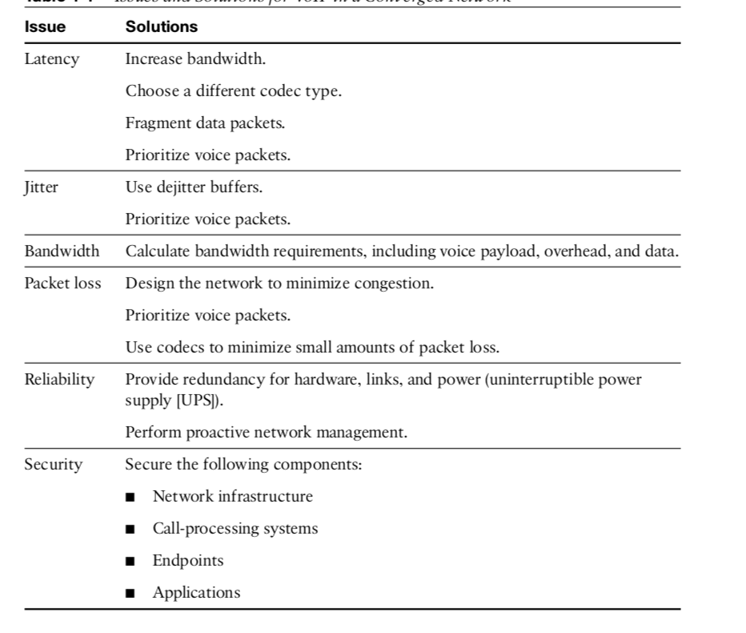
Issues and Solutions for VoIP in a Converged Network

